Slide 1

What affects the quality of water?
Jay Kim

Slide 2
Research Questions
What are the defining features related to poor water quality by state?
Which of these factors should agencies focus efforts on to maximize improvements in water quality?

Slide 3
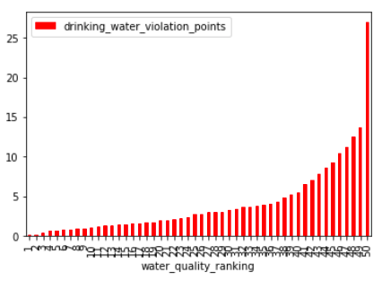
What is water quality ranking?
Water quality ranking strongly depends on drinking water violation points
Drinking water violation points are a “weighted point system”, which tracks the violations that include “contaminants and treatment”.

Slide 4
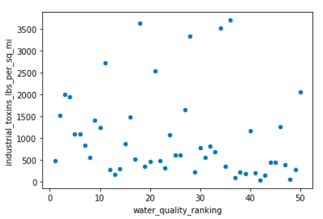
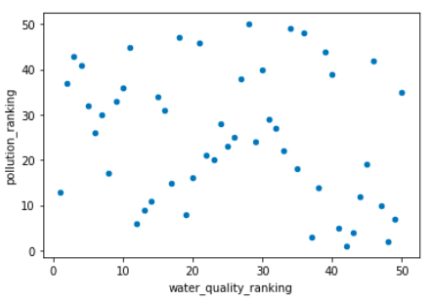
How much do industrial toxins affect the quality of water?
Surprisingly, there is no strong correlation between water quality and industrial toxins or the amount of pollution in the area.

Slide 5
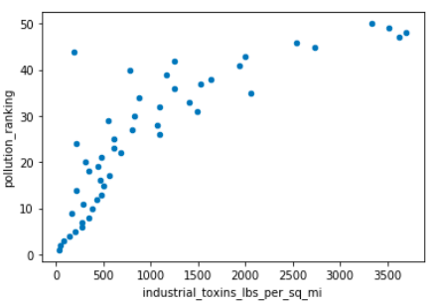
Pollution VS. Industrial toxins in SQ. Miles?
Meanwhile, there is a strong correlation between the pollution ranking and the amount of industrial toxins per square mile.

Slide 6
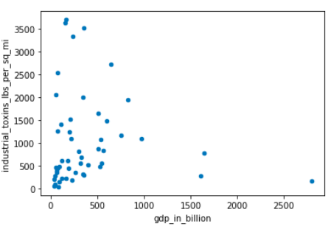
What factors can affect industrial toxins?
As GDP gets lower, there is a greater possibility of having higher levels of industrial toxins, and as GDP gets higher, that possibility decreases.

Slide 7
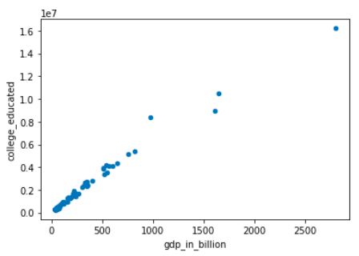
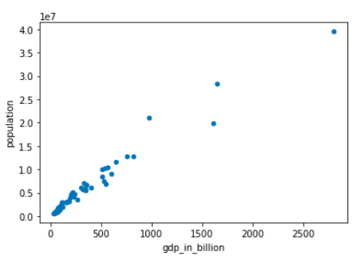
Then how do we increase GDP?
GDP tends to be higher in areas with larger populations and more highly educated individuals.

Slide 8
Conclusion
According to the data, water quality had little to no correlation to any of the other factors (GDP, industrial toxins, pollution ranking, number of college educated) except drinking water violation points.
Existing Relationship Summary:
Industrial toxins & pollution ranking: strong positive correlation
GDP & industrial toxins: negatively exponential correlation
GDP & population: strong positive correlation
GDP & college education: strong positive correlation

Slide 9
Follow Up Question & Further Research
Question: Why was there no correlation between water quality and any of the other data categories?
Yielded Research:
While industrial toxins and overall pollution is a result of human action (or inaction), water quality is largely dependent on many geographical factors beyond human control. Some factors include sedimentation, erosion, dissolved oxygen, pH, runoff, and decayed organic materials. Because of the the wide range of contributing factors, it’s difficult to graph direct correlation between water quality and any one factor, as proven in my data.

Slide 10
Works Cited
“What Are the Key Factors That Influence Water Quality?” Water Quality Information - What Are the Key Factors That Influence Water Quality? | APEC Water, www.freedrinkingwater.com/water_quality/quality2/j-19-08-key-factors-influencing-water-quality.htm.
“These States Have the Best Air and Water Quality in the U.S.” U.S. News &amp; World Report, U.S. News &amp; World Report, www.usnews.com/news/best-states/rankings/natural-environment/air-water-quality.

